Slide 1
STUDYING INFORMATION SYSTEM SONALI BANK LTD.

Slide 2
Presented To
Mr. Md. Iftekharul Amin
Assistant Professor
Institute Of Business Administration
University Of Dhaka

Slide 3
Presented By
Group 3
Tahlil-803
Tulshi Chandra Das-811
Saara Sheneen-833
Maloy Kanti Sarkar-834

Slide 4
Presentation Outline
Introduction
Background
Objectives
Scope
Limitations
Methodology
Findings
Conclusion

Slide 5
Introduction
Data is information that has been translated into a form that is efficient for movement or processing.
Information technology (IT) is the use of computers to store, retrieve, transmit, and manipulate data, or information.
Information system, an integrated set of components for collecting, storing, and processing data and for providing information, knowledge, and digital products

Slide 6
Background
The history of information systems only spans five decades.
First era: Mainframe and minicomputer computing
Second era: Personal computers
Third era: Client/server networks
Fourth era: Enterprise computing
Fifth era: Cloud computing

Slide 7
Background (cont.)
First Era: The first era, pre-1965, was the period of huge mainframe computers. Requirements are
Temperature control
Skilled people
Costly
Time sharing

Slide 8
Background (cont.)
Second Era: The second era of personal computers started in 1965 with the introduction of the microprocessor.
Comparatively lower cost
Operated by ordinary people
Comparatively higher speed

Slide 9
Background (cont.)
Third Era: The third era of personal computers started in 1980.
Developed power
Developed anatomy
Client-server network

Slide 10
Background (cont.)
Fourth Era: The forth era started in 2000.
High speed network
Integration of enterprise software solutions
360 degree view

Slide 11
Background (cont.)
Fifth Era: Present age
Faster processor
Easy usage of software
Exponential growth of internet speed
Cloud computing

Slide 12
Background (cont.)
The six major types of information systems corresponding to each organizational level are:
Transaction Processing Systems (TPS): serve the operational level of an organization.
Knowledge work systems (KWS)
Office automation systems (OAS): to serve the knowledge level of an organization.

Slide 13
Background (cont.)
Decision-support systems (DSS)
Management information systems (MIS) serve the management level of the organization.
Executive support systems (ESS) serve the strategic level of an organization.

Slide 14
Background (cont.)
Components of information system are –
1. Hard-ware: Computer-based information systems use computer hardware, such as processors, monitors, keyboard and printers.
2. Software: These are the programs used to organize, process and analyze data.
3. Databases: Information systems work with data, organized into tables and files.

Slide 15
Background (cont.)
4. Network: Different elements need to be connected to each other, especially if many different people in an organization use the same information system.
5. Procedures: These describe how specific data are processed and analyzed in order to get the answers for which the information system is designed.

Slide 16
Broad Objectives
Culture of organization
Qualification for getting job
Recruitment process
Managerial level
Employee motivation
functions

Slide 17
Specific Objectives
to learn about the existing information system(s) which are running in the organization
to observe existing workflow
to learn about the advantages and disadvantages of using the system(s)
to know how they maintain the system(s)

Slide 18
Specific Objectives (cont.)
to know the associated cost of the system(s)
to know how they train their employee for using those systems

Slide 19
Scope
the information system of "Sonali Bank LTD".

Slide 20
Limitations
Time
Detailed information about organizations’ culture
Detailed information about recruitment process
Functions of other departments

Slide 21
Methodology
Primary Source: employees of "Sonali Bank LTD".
Data Source-
Secondary Source: website of "Sonali Bank LTD".

Slide 22
Methodology (cont.)
Interviewing employees of "Sonali Bank LTD".
Data accession method-
Visiting the official website of "Sonali Bank LTD".

Slide 23
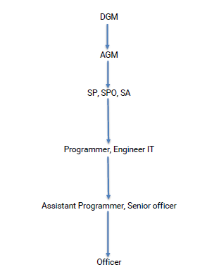
Findings
Existing Workflow

Slide 24
Findings
Software Management Team of Sonali Bank
Developer team
Support team
Change team
Tester team

Slide 25
Findings (cont.)
Centralized Software
1. Store data from all branches
2. Maximum data are stored here
Decentralized Software
1. Store data from particular branches
2. Store the local data necessary of
particular branch

Slide 26
Findings (cont.)
Online branch banking
1. CBS software is used for
online banking.
2. CBS is a centralized
software
3. CBS is a special software
in Sonali Bank LTD.

Slide 27
Findings (Cont.)
1. CBS, GTS for Govt.
transaction
2. Sonali Seba provide
service to different
company
Banking Software

Slide 28
Findings
Operating Systems
Mostly Windows
AIX for CBS software
Linux for tearing software

Slide 29
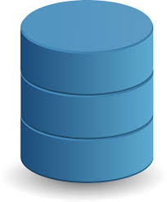
Findings
Storage system
Use DC and DR storage system
Synchronize in real time
Daily backup called incremental backup is used
Backup size is 100GB
Data increase 1 GB daily and they backup it
Sometimes mobile hard drive is used
Source:https://pixabay.com/en/database-data-storage-cylinder-149760/

Slide 30
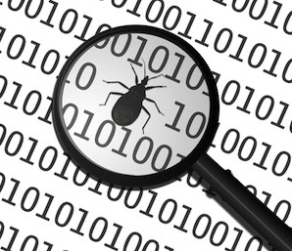
Findings(Cont.)
Fixing Bug of Software
Sonali Bank notify the vendor company
Vendor company fix the bug
Source:https://www.mytechlogy.com/IT-blogs/6967/10-reasons-why-you-should-fix-bugs-as-soon-as-you-find-them/

Slide 31

Findings (cont.)
Security
Maintain physical and technical security
use routers, switch to maintain data software
use antivirus centrally
Use Core Cal license to control branches
https://vizorsoftware.com/vizor-expands-senior-management-team/
Source: https://vizorsoftware.com/vizor-expands-senior-management-team/

Slide 32
Conclusion
Proper use of information technology can lead to the achievement of expected skills.
Technology can play a vital role in the eradication of corruption by bringing in transparency in the state machinery.

Slide 33
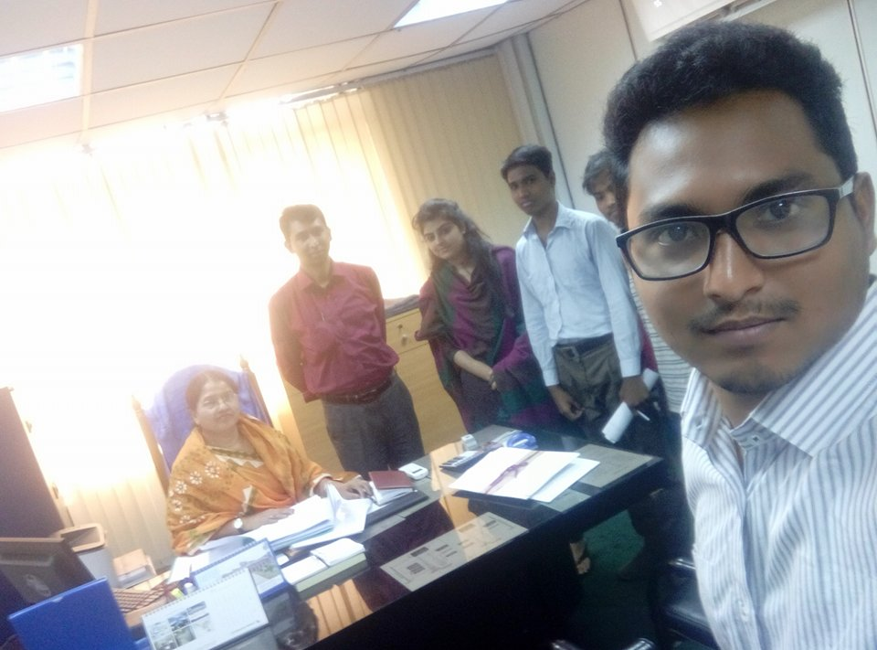
Figure1: Group 3 with AGM and a developer of Sonali Bank

Slide 34
Q/A

Slide 35
Thanks!
Any questions?
You can find us at bsse0803@iit.du.ac.bd, bsse0811@iit.du.ac.bd, , bsse0833@iit.du.ac.bd, bsse0834@iit.du.ac.bd,

